Slide 1
Populations, Samples, and Sampling
Chad Williams
University of Victoria

Slide 2
Lecture Outline
Population and Sample
Models of Hypothesis Testing
Probability

Slide 3
Lecture Outline
Population and Sample
Models of Hypothesis Testing
Probability

Slide 4
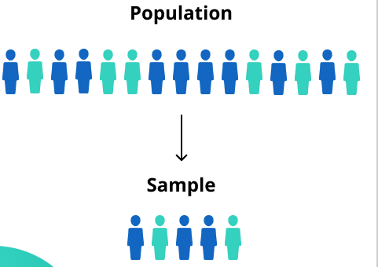
Populations and Samples
Population: An entire set of data trying to be estimated by statistics
Can be empirical if we can measure every single thing (person, animal, event, etc.) in the population
Most often theoretical when we define it mathematically without all data
The population of interest is decided by the experimenter
E.g., every Canadian

Slide 5
Populations and Samples
Sample: Subset of observations from persons, animals, events, etc. for a given population
Always empirical – our collected, observed data
We assume that it represents the population of interest because of our sampling models used:
Random Sampling
Random Assignment
The samples included are decided by the experimenter
E.g., The first thousand Canadians to respond to my survey

Slide 6
Populations and Samples
 | Populations | Samples
Descriptive | Parameters | Statistics
Mean | μ | x̄
Standard Deviation | σ (sigma) | SD or s
Variance | σ² (sigma-squared) | SD² or s²
Note: SD² and SD are for descriptive statistics (Unit 1.3.), while s and s² are for inferential statistics (Unit 4.3. & Psyc 300B)

Slide 7
Lecture Outline
Population and Sample
Models of Hypothesis Testing
Probability

Slide 8
Models of Hypothesis Testing
We assume that our sample represents the population of interest because of our sampling models used
Requires a random process: random sampling or random assignment
Each datum is independent from each other
e.g., same event/person/etc. cannot be recorded twice
But also if a person that gets chosen from a study that has learned about the study from a friend who did the study earlier is not independent

Slide 9
Models of Hypothesis Testing
Samples are a subset of the population, but who gets to be in that subset?
Random Sampling Model: A scientific method for determining a sample, which presumes every person in the population has an equal chance of being selected as part of the sample
Necessary as we are trying to represent the population

Slide 10
Models of Hypothesis Testing
Samples are a subset of the population, but who gets to be in that subset?
Random Assignment Model: A scientific method for determining a sample, which presumes every person has an equal chance of being assigned to either condition (e.g., drug group vs placebo group)
Necessary as we are trying to represent the population

Slide 11
Models of Hypothesis Testing
Forms of Random Sampling/Assignment
Simple Random Sampling: Every person of the population has an equal chance of being selected
Most often impossible
Also called True Random Sampling

Slide 12
Models of Hypothesis Testing
Forms of Random Sampling/Assignment
Convenience Sampling: Determine a pre-defined subset of individuals to select our sample from because that’s what we have access to
E.g., Psychology undergraduate students
We then must rely on random assignment
Cannot generalize further than psyc undergrads

Slide 13
Models of Hypothesis Testing
Forms of Random Sampling/Assignment
Random Sampling/Assignment with Restriction: Every person of the population that holds an experimenter-determined characteristic has an equal chance of being selected
E.g., individuals with schizophrenia

Slide 14
Models of Hypothesis Testing
Forms of Random Sampling/Assignment
Stratified Random Sampling/Assignment: Pre-existing representation of the population
Using known proportions of the population to guide who is recruited
E.g., proportionate representation of ethnic diversity of the community

Slide 15
Models of Hypothesis Testing
Western Educated Industrialized Rich Democratic (WEIRD) Samples
Psychology uses a narrow, unrepresentative slice of humanity, despite generalizing findings to humans as a whole
Petrutiu et al., 2026: Looked at British-hosted journals between 2021 and 2023
68% of samples recruited from Western countries
North America, Europe, Australia, New Zealand, etc.
E.g., 20% from UK, 17.7% from US
19% of studies only used undergraduate students
Henrich et al., 2010: Looked at journals between 2003 and 2007
96% of samples from rich and industrialized countries
Petrutiu et al., 2026

Slide 16
Lecture Outline
Population and Sample
Models of Hypothesis Testing
Probability

Slide 17

Probability in Statistics
Inferential Statistics: Compares two or more things to determine if they are the same or different
The decision of whether two+ things are the same or different is actually a probability of how likely it is that they are the same
Low p-values (e.g., p = .05 or 5% chance) says the two things are not likely the same
High p-values (e.g., p = .85 or 85% chance) says the two things are likely the same

Slide 18
Probability in Statistics
Probability: The likelihood of occurrence or possibility of an outcome
The certainty that an event will occur
Expressed as proportion (so, it’s between 0 and 1)
We use p to represent probability in statistics
We used the z-score table last unit to get p-values of different z-score values

Slide 19
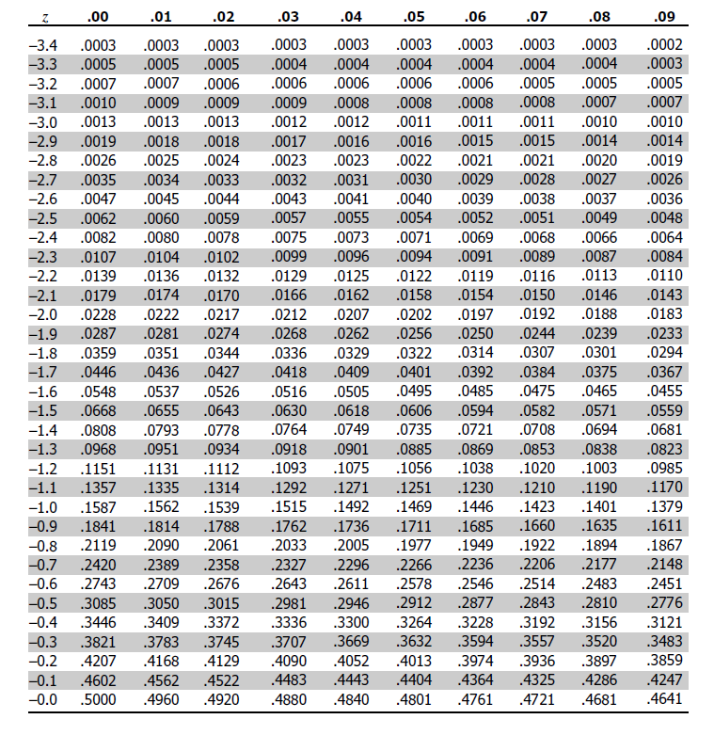
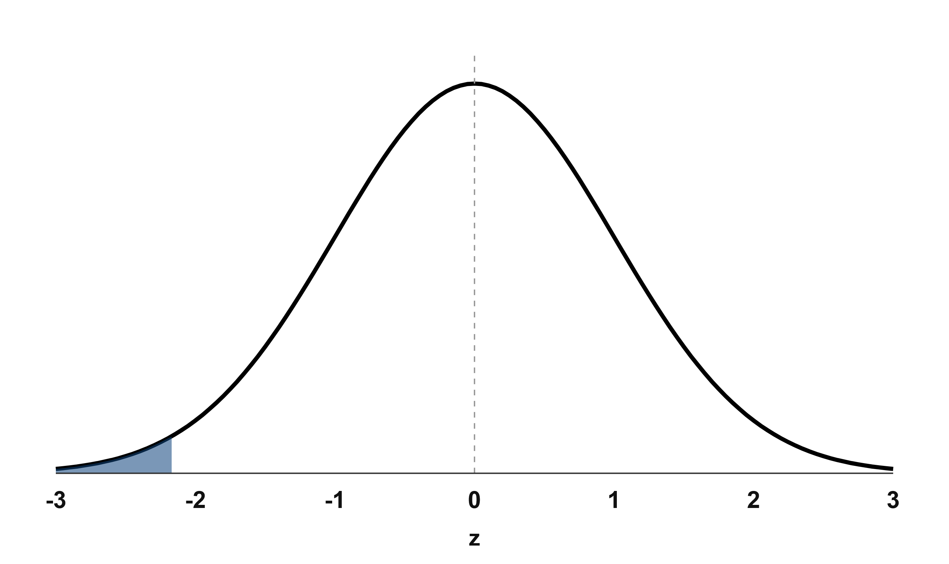
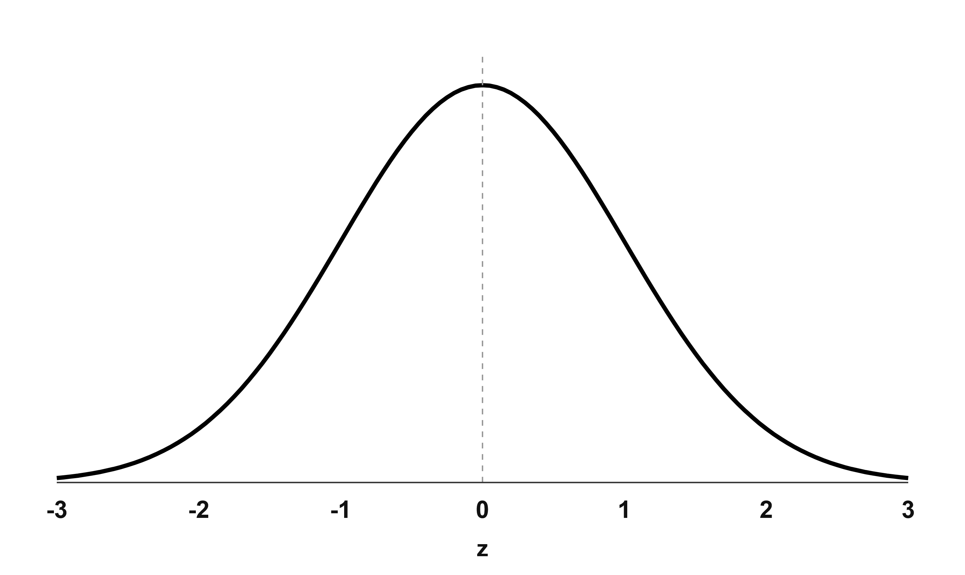
Probability in Statistics
What is the probability that two groups are the same if the z = -2.17?
p = .0150 (1.50%)

Slide 20
Extra Resources

Slide 21

Extra Resources

